Slide 1

Name of student: Naman Bhayana
Roll number: 102003356
Branch: COE

Slide 2

Job Consultancy Platform
Industry Mentor: Mr. Rajinder Singh
Faculty Mentor: Dr. Seemu Sharma
Oragnization: Techlive Solutions Mohali
Role: Jr. Mern Stack Developer
Start Date of Internship: 01/02/24
End Date of Internship: 30/06/24

Slide 3

About the Company
Tech-live is an advanced Software Technology Training cum Development Company, training students and fresher’s and transforms them into experts. We are a leading custom development and software outsourcing agency since 2013. Our company focuses on the development of customized software applications and offshore software outsourcing facilities. Techlive is also an excellent Training company based in Chandigarh | Mohali providing International Certifications.

Slide 4
Key Features Of Company
01
User-Friendly Interface
02
Practical Learning and Projects:
Techlive provides an intuitive and easy-to-use interface for training seeking candidates.
We believe that students can learn best with practical knowledge.
03
Focus on Quality training
04
Expert Mentorship and Faculty
Techlive main focus is to provide world class training to its trainees and the certificates are provided from big tech companies like Google
We have expert faculty for training and assistance purposes.

Slide 5
Project Background
This project was initiated to address the inefficiencies in traditional job consultancy methods. In today's job market, both job seekers and employers often face challenges in connecting effectively, leading to prolonged job searches and inefficient recruitment processes. Using modern web technologies like the MERN stack, the project aims to create a user-friendly platform to overcome these challenges. The goal is to provide intuitive interfaces for job seekers to explore opportunities and for employers to manage listings efficiently, transforming the job recruitment landscape by enhancing accessibility and efficiency.

Slide 6
Project Scope and Utility
Scope:
User Interfaces: Design simple interfaces for job seekers and employers.
Backend Development: Build a strong backend for managing jobs and user data.
Database Management: Use MongoDB for storing user profiles and job listings.
Security Measures: Implement secure login, data encryption, and regular security checks.
Performance Optimization: Ensure the platform runs smoothly and can handle more users over time.
Utility:
Better Connections: Helps job seekers and employers find each other easily.
Time Efficiency: Simplifies the job search and recruitment process.
User-Friendly: Offers easy-to-use features for all users.
Scalability: Can grow to support more users without slowing down.
Data Security: Protects user information with strong security measures.

Slide 7
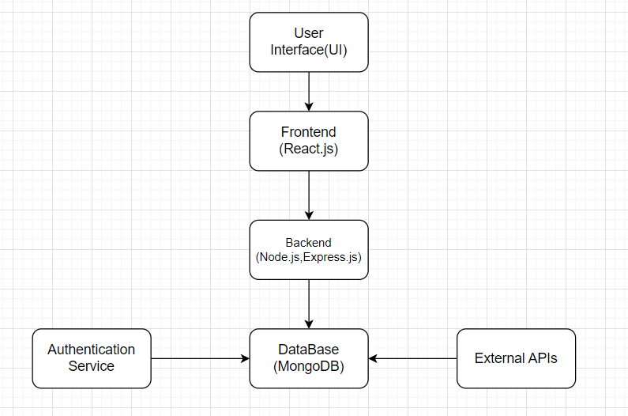
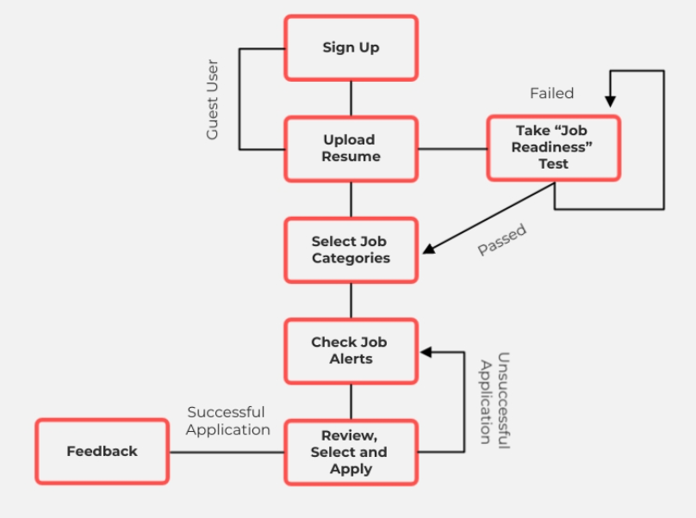
Project Architecture

Slide 8



Techniques and Tools Used
1) Frontend Development:
React.js: For building responsive and interactive user interfaces.
CSS/SASS: For styling and designing the visual aspects of the platform.
Redux/React Context API: For managing state across the application.
2) Backend Development:
Node.js: For server-side scripting and building the backend.
Express.js: For creating robust APIs and handling server requests.
JWT (JSON Web Tokens): For secure user authentication and session management.
3) Database Management:
MongoDB: For storing and managing data in a NoSQL database.
Mongoose: For modeling and interacting with MongoDB within a Node.js environment.
4) Development Tools:
Visual Studio Code: As the primary code editor.
Git/GitHub: For version control and collaboration.
npm (Node Package Manager): For managing project dependencies.
5) Testing and Quality Assurance:
Postman: For API testing and debugging.

Slide 9
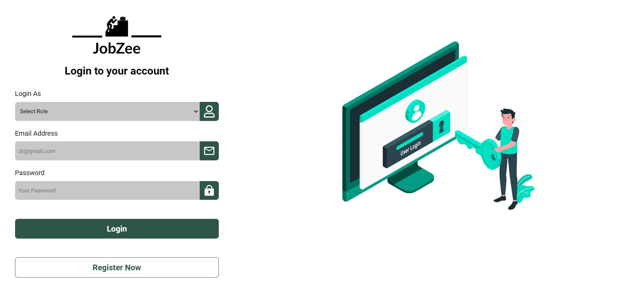
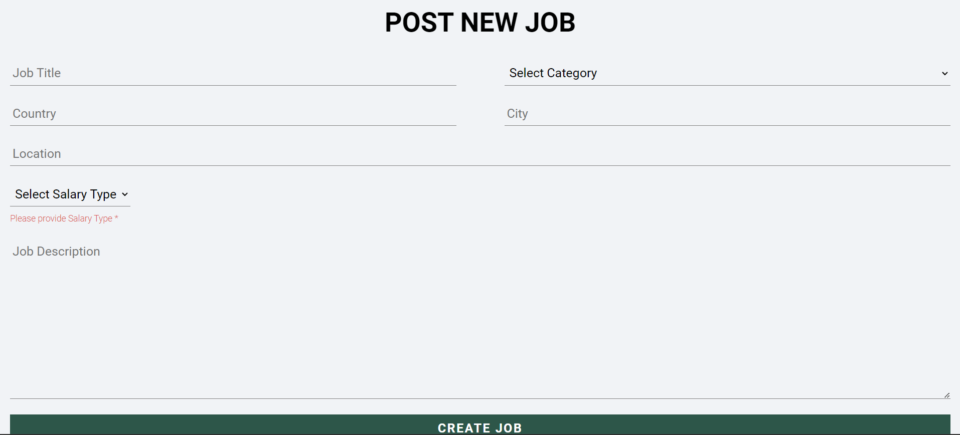
Relevant Snapshots
Login Screen
Recruiters can post new job

Slide 10
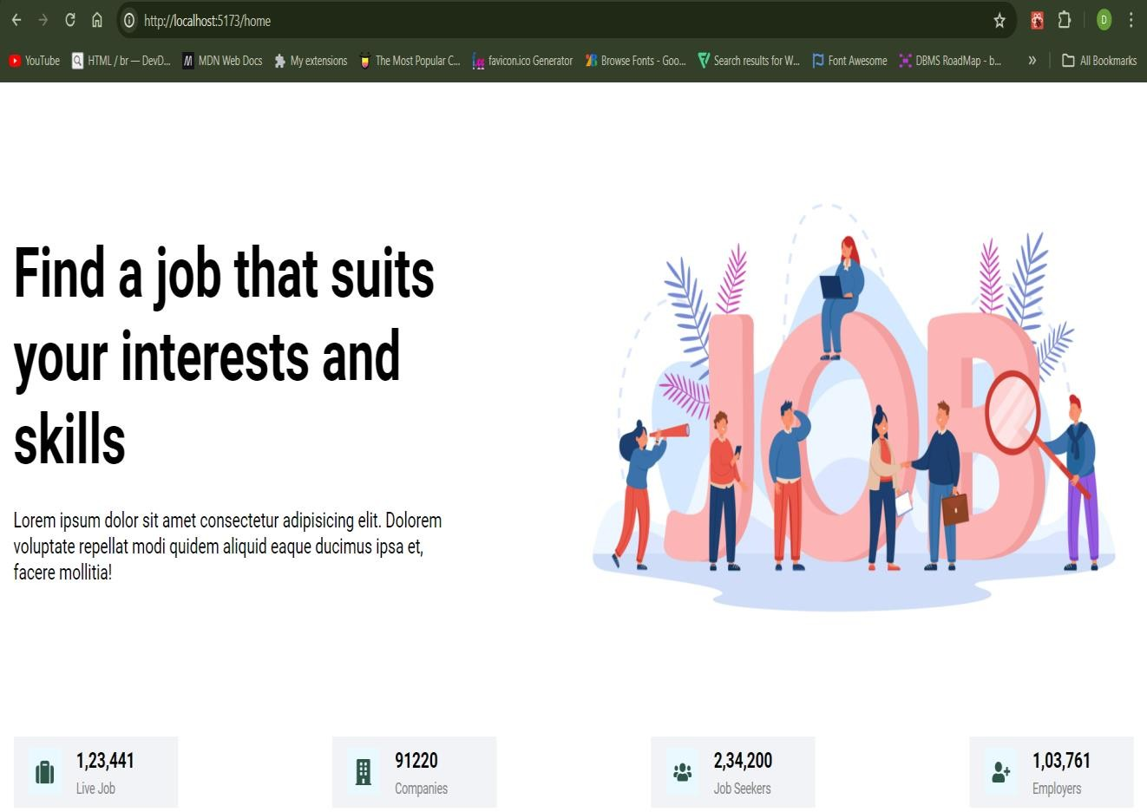
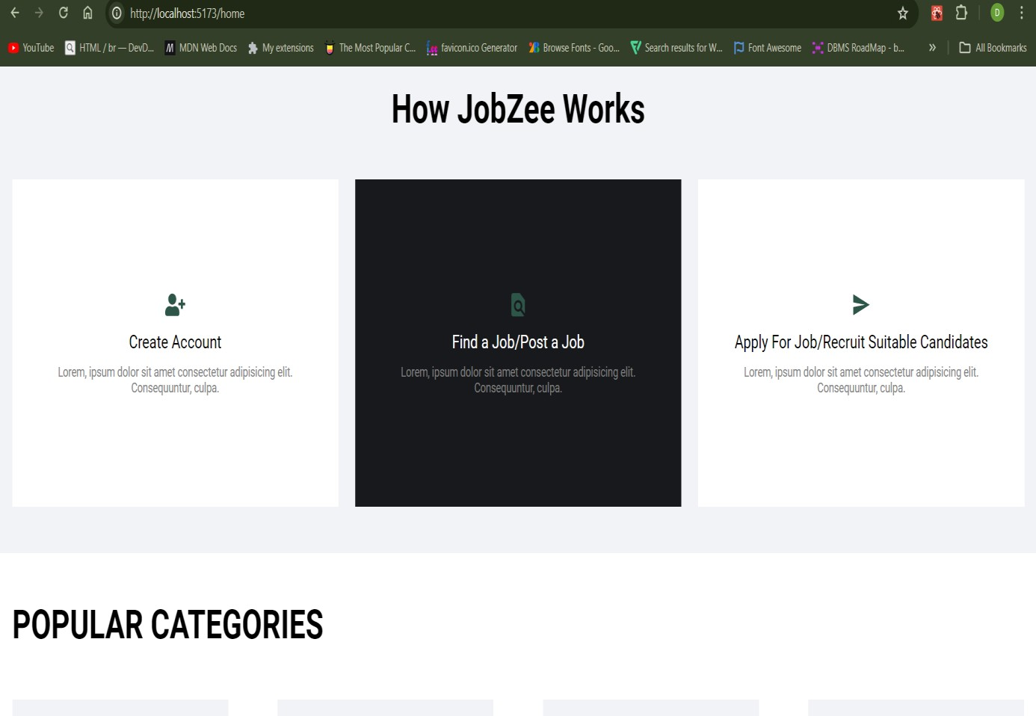
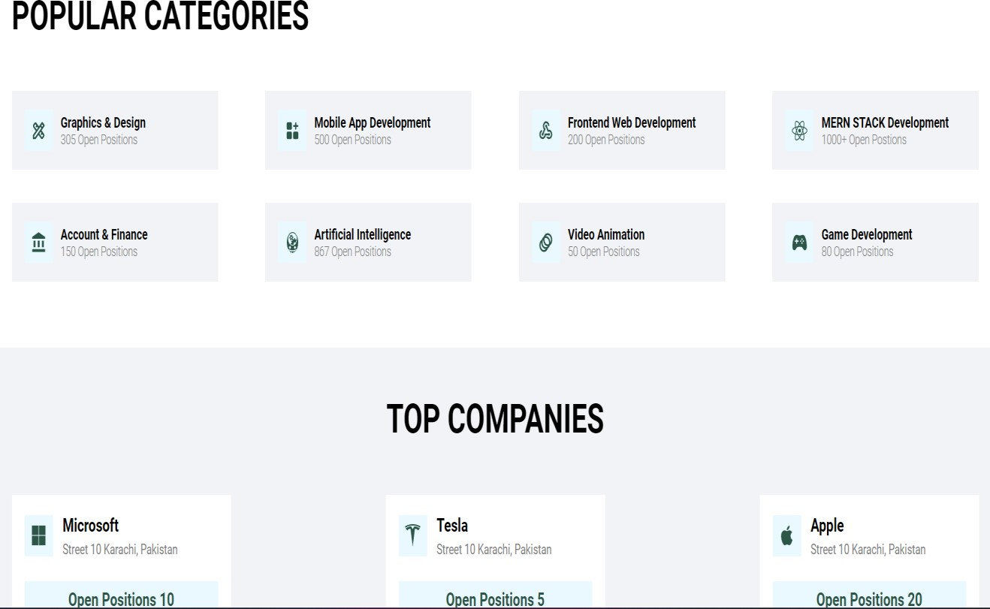
Dashboard and Extended Dashboard

Slide 11
Professional and Technical Learning
Frontend Development:
Skilled in building dynamic user interfaces and integrating frontend with backend services.
Backend Development:
Expertise in creating RESTful APIs, managing databases, and implementing authentication/authorization.
Database Management:
Experience in designing and managing databases.

Slide 12
Debugging and Problem-Solving:
Enhanced ability to troubleshoot and resolve technical issues efficiently.
Project Management and Collaboration:
Improved project management skills, including task planning, progress tracking, and time management. Gained valuable experience in collaborating with a team, participating in code reviews, and integrating feedback.

Slide 13
Project Timeline
Started Learning Node.js, Express.js, MongoDb
Gained Concepts of Html , Css
Implementation of Frontend
Implementation of Backend and integration with Frontend
Started Learning JavaScript and React
February
March
April
May
June
01
02
03
04
05

Slide 14
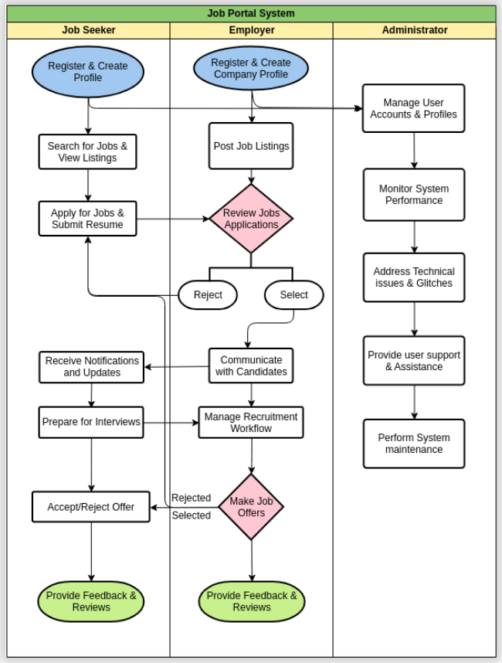
Flowchart
It visually represents the main phases and key activities involved in developing the platform. The flowchart provides a clear sequence of steps, ensuring all stakeholders understand the process from requirement gathering to continuous maintenance.

Slide 15
Methodology
Requirement Gathering and Analysis
Design and Planning Frontend
Development Backend Development
Integration of Frontend and Backend
Testing and Quality Assurance
Deployment and Rollout
Continuous Monitoring and Maintenance
Implementation
Set up development environment for MERN stack.
Use tools like Visual Studio Code and Postman.
Install and configure MERN stack components.
Develop backend with Node.js and Express.js. Integrate MongoDB for database management.
Create dynamic UI with React.js.
Implement authentication and authorization.

Slide 16
Future Scope of Project
Advanced Search and Filtering Functionality
Increasing Scalability
Enhanced Communication Features
Advanced Job Matching Algorithms
Integration with Professional Networking Sites
Skill Development and Training Resources
Collaboration with Educational Institutions
Artificial Intelligence Integration
Expansion into Niche Markets Partnerships with Recruitment Agencies

Slide 17

Key Features
User Authentication and Authorization:
Secure registration and login system with role-based access control for job seekers, employers, and administrators.
Job Search and Filtering:
Advanced search functionality with filters based on location, industry, experience level, and more for job seekers.
Job Posting and Management:
Easy-to-use interface for employers to post job listings, manage applications, and communicate with applicants.
Real-Time Notifications:
Instant notifications for job application updates and new job postings.
Responsive Design:
Ensured seamless user experience across various devices and screen sizes.

Slide 18
Video Link
Click Here

Slide 19
Feedback
Project Semester
The project semester was a great learning experience. We gained practical skills in using modern web technologies like the MERN stack and improved our ability to work as a team. Managing different parts of the project taught us how to organize our time and prioritize tasks effectively. Facing and solving various technical issues helped us become better problem solvers and thinkers. Overall, this hands-on approach prepared us well for real-world applications.
Faculty Visit
The faculty visit was immensely beneficial, offering valuable guidance and support throughout the project. Regular check-ins with faculty members provided us with expert advice on best practices for the internship. Their constructive feedback during evaluations helped us identify strengths and areas for improvement, refining both the project and our personal skills. The faculty's recognition of our efforts and achievements boosted our morale, and their suggestions for future development provided a clear roadmap for post-semester enhancements and scalability.

Slide 20
Conclusion
In conclusion, my internship journey at Techlive Solutions has been immensely rewarding. Through hands-on experience with the MERN stack, I've not only enhanced my technical proficiency but also developed a deeper understanding of effective collaboration within a team setting. I'm grateful for the guidance and support provided by the Techlive Solutions team, and I'm excited to leverage the skills and knowledge gained during this internship in my future endeavors. This experience has reinforced my passion for software development and has prepared me for the challenges that lie ahead in my career journey.

Slide 21
Thank You

